Slide 1
"Gheorghe Asachi“ Technical University
Automatics and Computer Science Faculty
Distributed Systems and Web Technologies
Desktop Conferencing System
Project Manager:
Conf. dr. ing. Mihai Horia ZAHARIA Graduate Student:
Darie Mihai

Slide 2
Brief Introduction
Most important aspects of the application context are :
  Computational environment: processors, hard-disks, devices;
  User environment: location, social status, neighbors;
  Phisical environment: luminosity, noise.

Slide 3
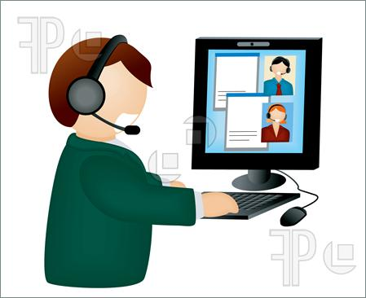
Application General Context

Slide 4

The proposed project is the development of an application for supporting desktop remote conferences (e.g. video, audio, screen sharing).
Remote conference architecture illustration

Slide 5
Project Design
Use Case Analysis
Characteristics and features analysis, described in the Use Cases diagram:
Actors identification
End User needs
Use Cases description

Slide 6
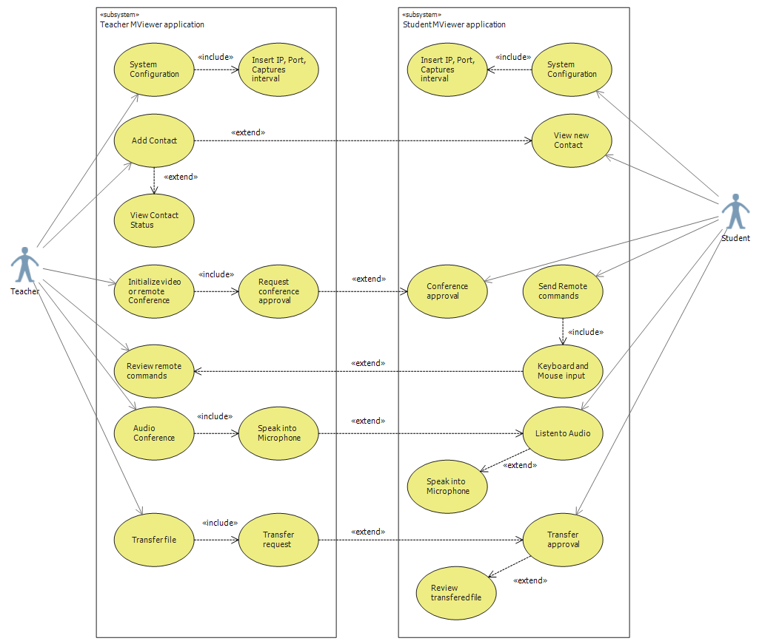
UML Use Cases diagram

Slide 7
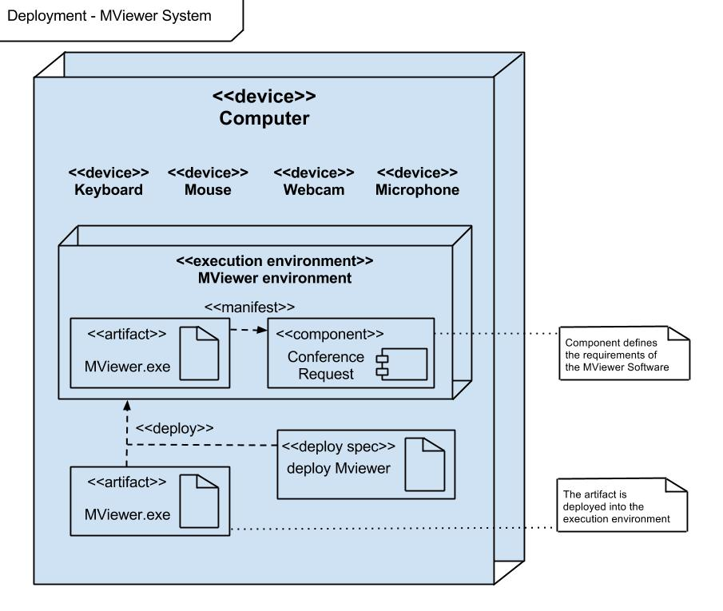
Deployment Diagram – presents the physical structure of the targeted system

Slide 8
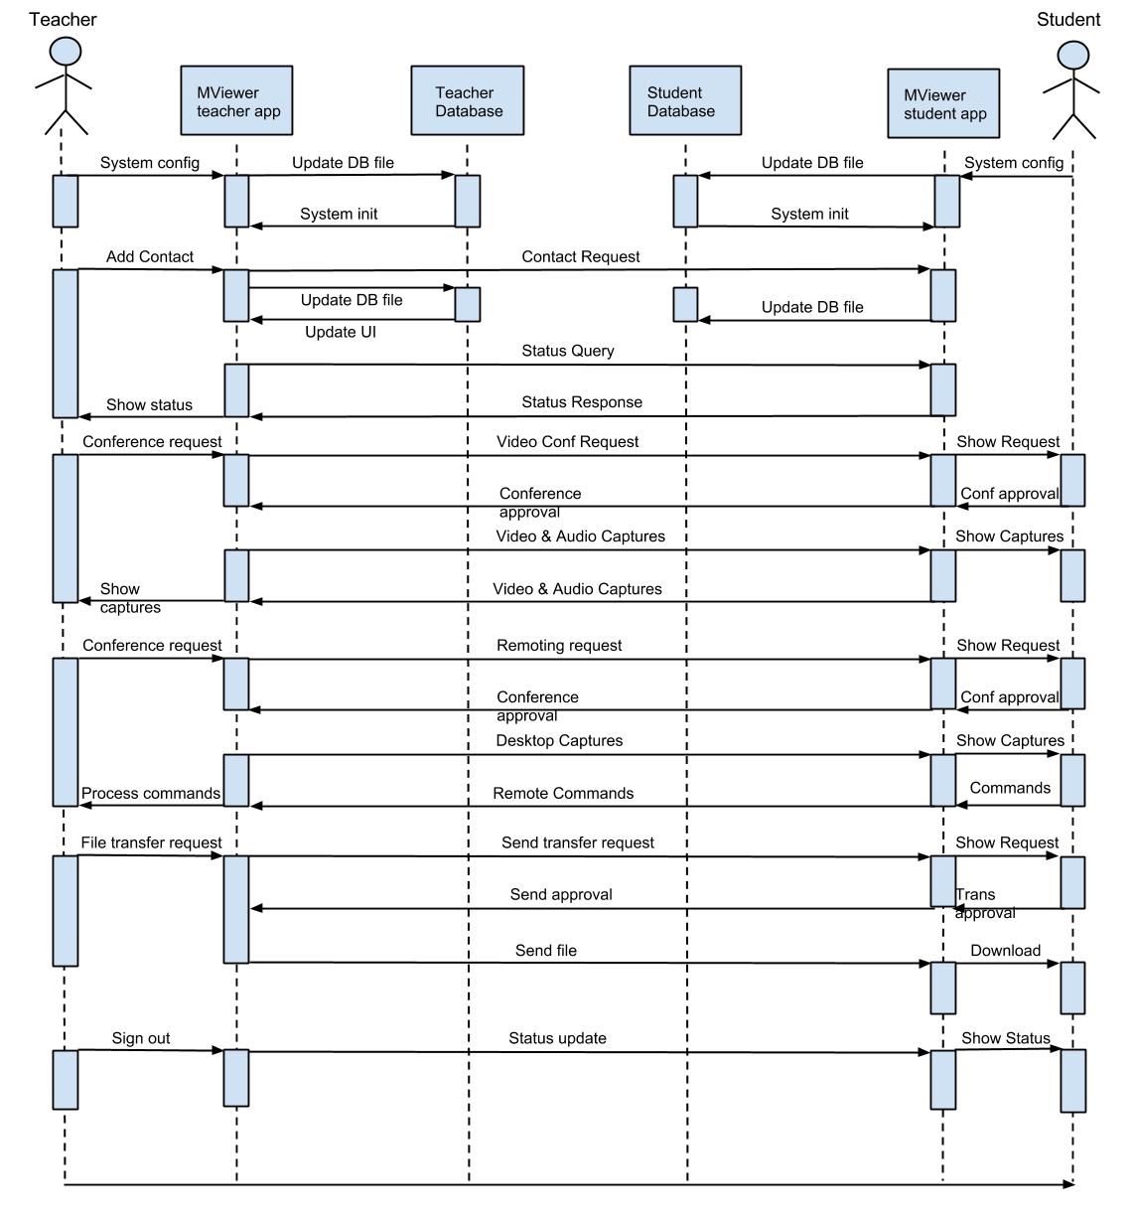
Sequence diagram of the targeted system

Slide 9
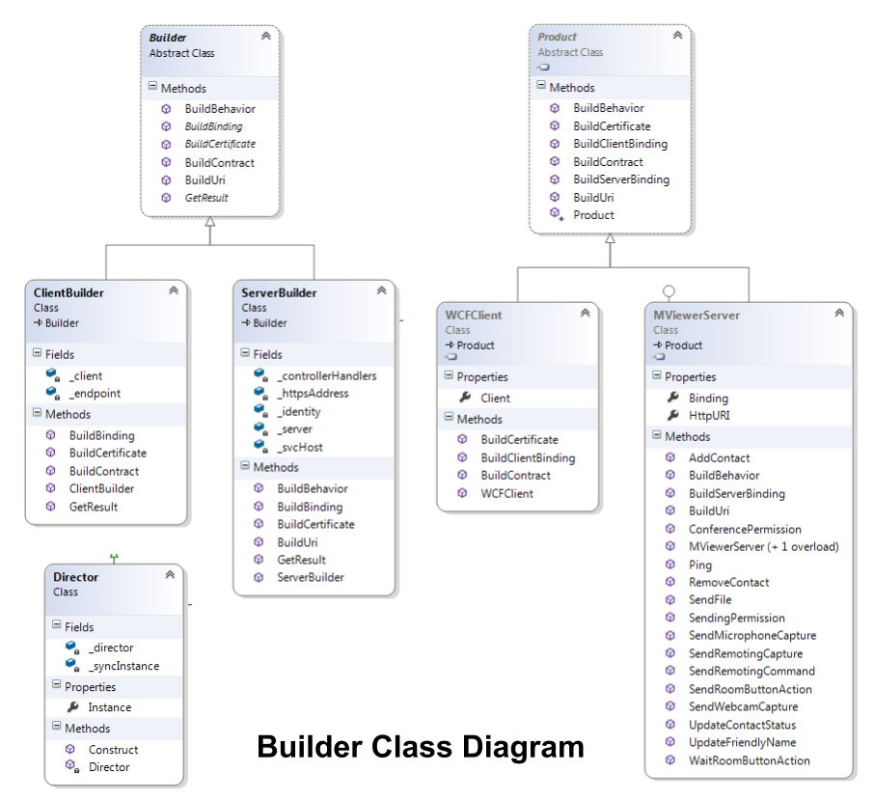
Notes:
Factory method

Slide 10
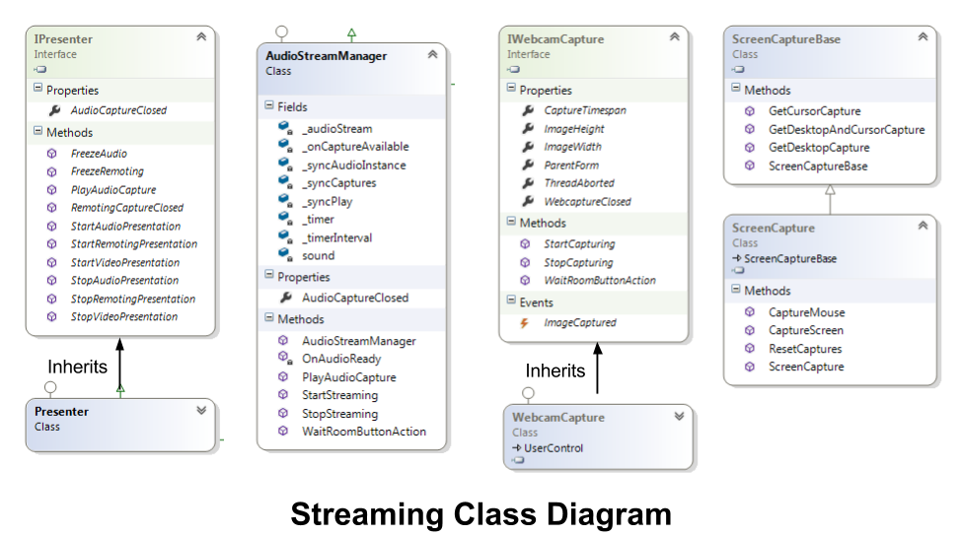

Slide 11
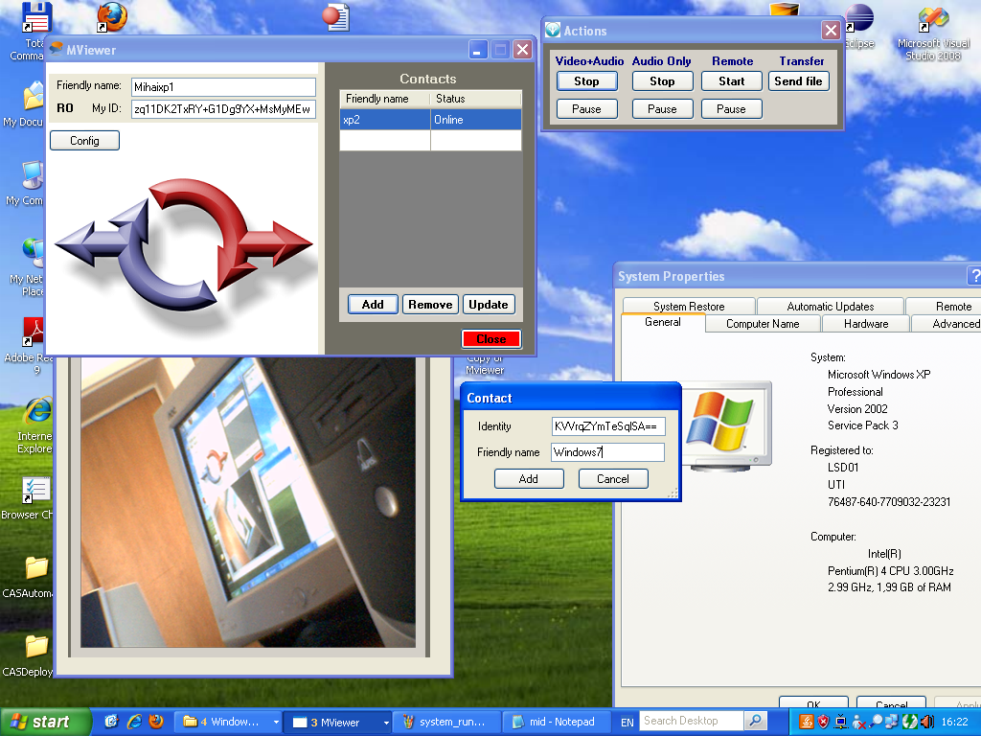
Video conference, capturing contact addition

Slide 12
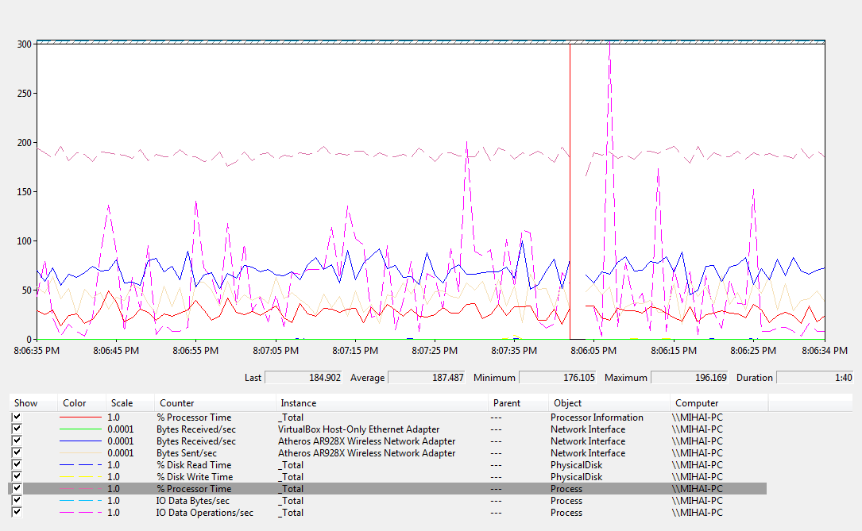
Obtained results and Data analysis
Resource load ratio on Asus Laptop 2.00 GHz, 3.0 GB RAM, Windows 7 32-bit

Slide 13
Thank you for your time

